Slide 1
IFB Requirement – Washing Machines & Air Conditioners

Slide 2
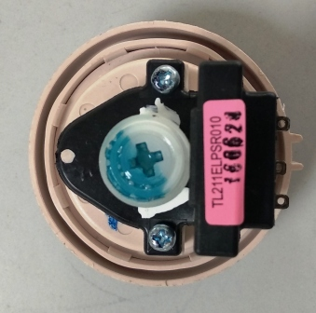
Washing Machine
Sr. No | Part Name | HS code | Basic Specification | Annual Volume | Photo
1 | Pressure sensor : Front loader | 90328990 |  | 960K pcs
2 | Pressure sensor : Top loader | 90328990 |  | 720K pcs
Level | Frequency HZ | Height mm
T1 | 23 | 185 +/- 12
T2 | 24.5 | 100 +/- 6
Reset | 25.5 | 35 +/- 10
Initial frequency | 26.15-26.8 | 0
Level | Frequency Hz | Water level mm
T1 | 21.6 | 500 +/ - 15
T2 | 22 | 445 + /- 10
T3 | 22.4 | 395 +/ - 15
T4 | 22.8 | 345 + /-15

Slide 3
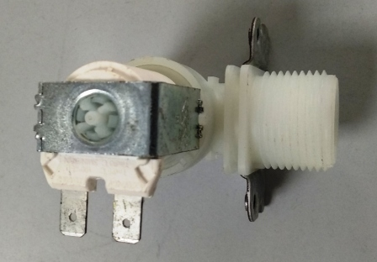
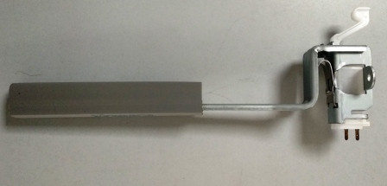
Washing Machine
Sr. No | Part Name | HS code | Basic Specification | Annual Volume | Photo
3 | Inlet valve | 84818090 | Coil Resistance : 4.5 K Ohm 220 -240 V ,50-60 Hz Rated current :Less than 35 mA | 720K pcs
4 | Safety Switch : Top loader |  | 15 V DC , 10mA | 720K pcs
Pressure | Flow rate lt per min
0.2 bar | 3 to 7)
1 bar | 7 to 13
3 bar | 12 to 20
5 bar | 13 to 23
8 bar | 15 to 25

Slide 4
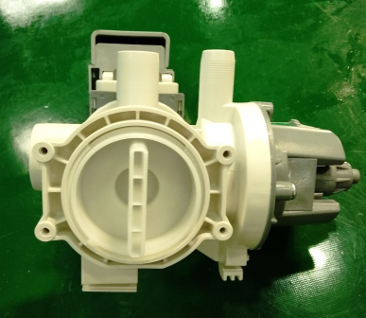
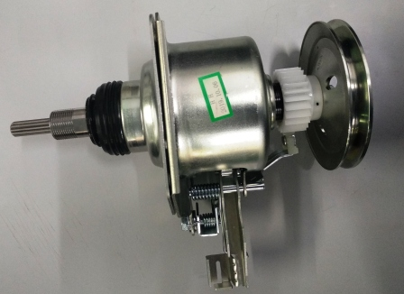
Washing Machine
Sr. No | Part Name | HS code | Basic Specification | Annual Volume | Photo
5 | Drain pump :Front loader | 84138190 | S2 Type duty cycle Flow rate : 18 l / min @ 1 meter ht. Brush less AC pump | 960K Pcs
6 | Clutch : Top loader | 84509010 | Wash RPM -135 Gear Ratio – 5.33 :! Braking torque -75 -115 Kgf-cm Spin RPM -720 | 720K pcs

Slide 5
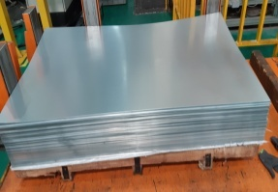
Washing Machine
Sr. No | Part Name | HS code | Basic Specification | Annual Volume | Photo
7 | PCM , PPGI sheets | 72107000 | Thickness : 0.6, 0.65 mm Width(mm) : 751* 1867 Zn coating : 120 GSM Mechanical properties : YS(Mpa) - 340-420 Mpa TS(Mpa) - 410-510 Mpa EL (%, GL)- Min 15 % at 80GL ECV (mm) - 6~7mm Color: White, Silver , grey | 3000 T
8 | ABS raw material | 39033000 |  | 2000 T | NA
Characteristic | Unit | Spec
Dark Spec | No / 200g | Max 10
MFI | gm/10 min | Min 4.0
Izod impact | J/m | Min 95
Tensile strength | kgf/cm2 | Min 250
Gloss @ 60 degree |  | Min 80

Slide 6
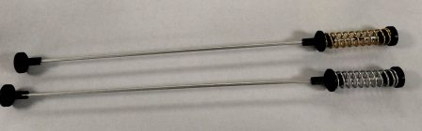
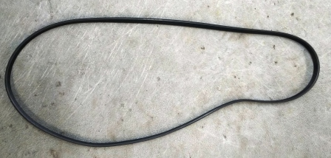
Washing Machine
Sr. No | Part Name | HS code | Basic Specification | Annual Volume | Photo
9 | Suspension assembly : 6 kg Top loader | 84509010 | Spring Diameter – 2.6 mm Spring OD -26.9 mm Total coils – 11 Active coils- 09 Spring constant -3.2 N/mm Free length Front : 105 mm Free length Rear – 100 mm Total length – 592 mm | 2800K pcs
10 | Poly V Belt | 40103390 | Top width : 9.6 +/- 0.2 mm Thickness : 2.5 +/- 0.3 mm Pitch : 1.6 mm Rib Ht : 0.8 +/- 0.1 mm No of ribs :6 Belt length : 1201 | 960K pcs

Slide 7
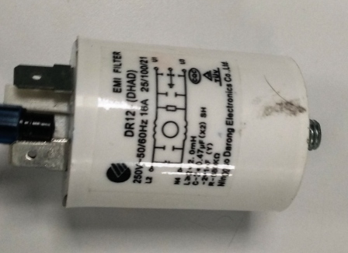
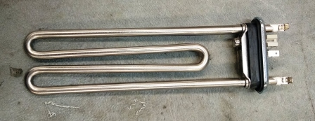
Washing Machine
Sr. No | Part Name | HS code | Basic Specification | Annual Volume | Photo
11 | EMI filter | 84509010 | 16A Current Leakage current : less than 0.8 mA Voltage drop : 1 V max HV test : 1.5 KV AC for 60 Sec | 960K pcs
12 | Heater | 84509010 | 2000 W heater with NTC :12K Double thermal fuse (167 degree C) | 960K pcs

Slide 8
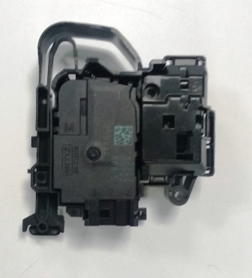
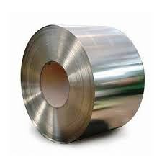
Washing Machine
Sr. No | Part Name | HS code | Basic Specification | Annual Volume | Photo
13 | Door lock : Magnetic | 84509010 | Solenoid + PTC type Mechanical lock position with 50 N applied on hook Emergency opening force > 100 N | 200K pcs
14 | Stainless Steel | 72201290 | ASTM 430 BA Finish Thickness : 0.4, 0.5, 0.6 mm 0.2%YS(Mpa) - 205 Min UTS(Mpa) - 450 Min EL (%, GL50 mm)- Min 30% | 4000 MT

Slide 9
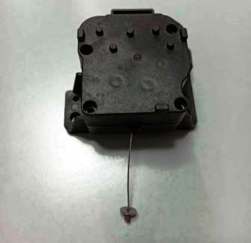
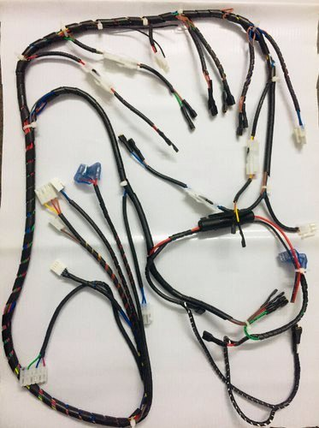
Washing Machine
Sr. No | Part Name | HS code | Basic Specification | Annual Volume | Photo
15 | Drain motor- Top loader | 85014090 | 220-240 V AC (50 /60 Hz) Input power -< 6 W Input current -<30mA Starting Voltage - <176 V Pulling force > 98N Pulling time <7 sec | 720K pcs
16 | Wire harness | 8544 | Drawing can be shared for complete details | 1500K pcs

Slide 10
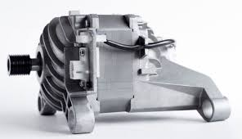
Washing Machine
Sr. No | Part Name | HS code | Basic Specification | Annual Volume | Photo
17 | BLDC Motor | 85014090 | DC 310V 500 rpm 1.90A 60W(wash) DC 310V 18000 rpm 2.35A 550W(spin) IP00 S3 60% (electronic protect) CL.F 8P | 960K

Slide 11
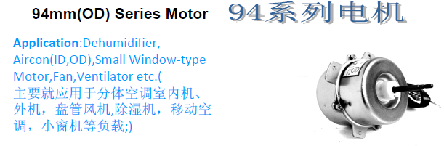
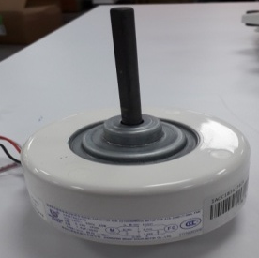
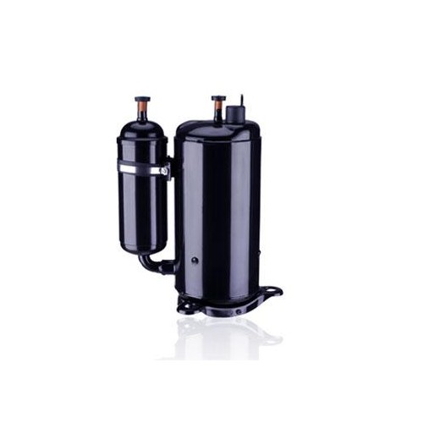
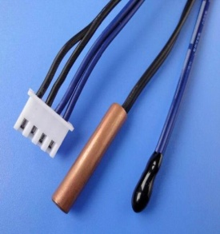
Air Conditioner
S. No | Part Name | HS code | Basic Specification | Annual Volume | Photo
1 | Axial Fan Motor | 84159000 | 25W AC 850RPM 38W AC 880RPM | 45K Pcs 455K Pcs
2 | Cross Flow Fan Motor | 85011020 | 21W AC 1320RPM 22W AC 1350RPM 45W AC 1280RPM 45W DC 1400RPM | 45K Pcs 275K Pcs 30K Pcs 150K Pcs
3 | Compressor | 84148011 | Single Rotary/R32/3000~3500(W)@60Hz Twin Rotary/R32/5000~5300(W)@60Hz Twin Rotary/R32/6400~7000(W)@60Hz | 45K Pcs 340K Pcs 115K Pcs
4 | Thermistor | 84159000 | Operating temperature range -40 deg C~105 deg C -50 deg C~150 deg C -30 deg C~105 deg C | 500K Pcs

Slide 12
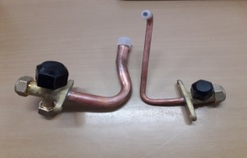
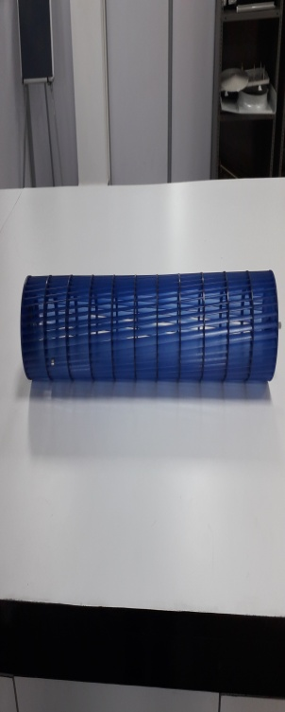
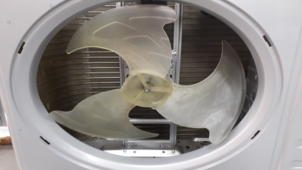
Air Conditioner
S. No | Part Name | HS code | Basic Specification | Annual Volume | Photo
5 | Service Valve | 84159000 | ½ “ R32 ¼ “ R32 | 500K Pcs
6 | Cross Flow Fan | - | Ф92X578 mm φ98×702 mm Φ111.5X753 mm | 45K Pcs 180K Pcs 275K Pcs
7 | Axial Fan | - | φ442×146 mm Ф410X130 mm | 45K Pcs 455K Pcs

Slide 13
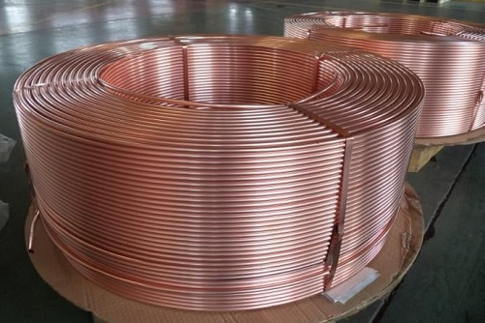
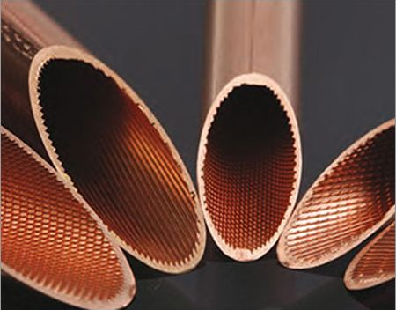
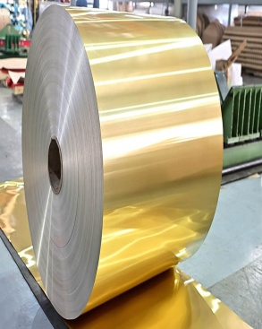
Air Conditioner
S. No | Part Name | HS code | Basic Specification | Annual Volume | Photo
8 | Plain Copper Tube | 74111000 | Plain Tube 6*0.5 mm Plain Tube 7*0.6 mm Plain Tube 9.52*0.7 mm Plain Tube 12.7*0.7 mm Plain Tube 6*0.6 mm Plain Tube 15.88*0.75 mm Plain Tube 7.94*0.65 mm Plain Tube 6.35*0.5 mm Plain Tube 12.7*0.6 mm Plain Tube 9.52*0.6 mm ** JIS H3300/C1220T | 850 MT
9 | Inner Groove Tube - Copper | 74111000 | 7 x 0.22 x 0.10 mm 5 x 0.20 x 0.15 mm ** JIS H3300/C1100T | 600 MT 810 MT
10 | Golden Hydrophilic Aluminium Foil | 76071994 | 845*0.095 mm 923*0.095 mm ** Alloy-3102/H26/500 hrs. SST | 1100 MT 645 MT

Slide 14
Air Conditioner
S. No | Part Name | HS code | Basic Specification | Annual Volume | Photo
11 | HIPS | 39033000 |  | 2200 MT | NA
Characteristic | Unit | Spec
Dark Spec | No / 200g | Max 10
MFI | gm/10 min | Min 4.0
Izod impact | J/m | Min 95
Tensile strength | kgf/cm2 | Min 250
Gloss @ 60 degree |  | Min 80

