Slide 1


WELCOME TO
DONG THAP

Slide 2

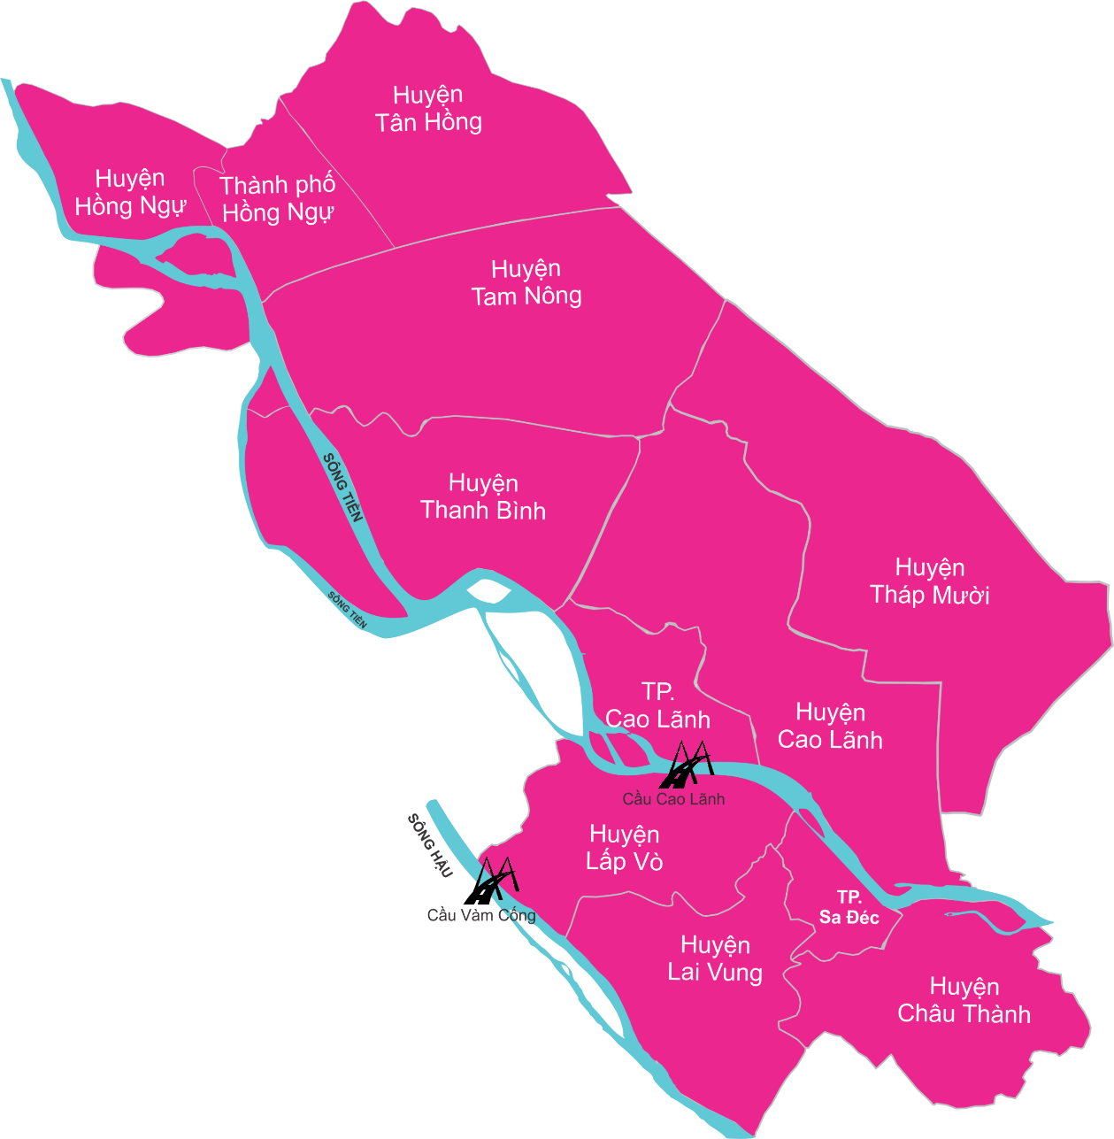
GENERAL INFORMATION
Total area: 338.385 ha (82,14% Agricultural land; 17,86% Non-Agricultural land)
Population: 1.598.754 people (798.855 men; 799.899 women)
Working age: 929.663 people (515.696 men/413.967 women, trained 13,45%
GRDP: 51,5 millions dong/people/year (2.223 USD)

Slide 3
Total retail sales of goods and service revenue
Economic structure:
+ Agriculture, forestry and fisheries: 35,41%
+ Industry and construction: 19,36%
+ Service: 45,23%
Total retail sales of goods and service revenue: 94.361 billions dong
Import and export turnover:
+ Exports: 1.340.601 USD
+ Imports: 388.205 USD

Slide 4
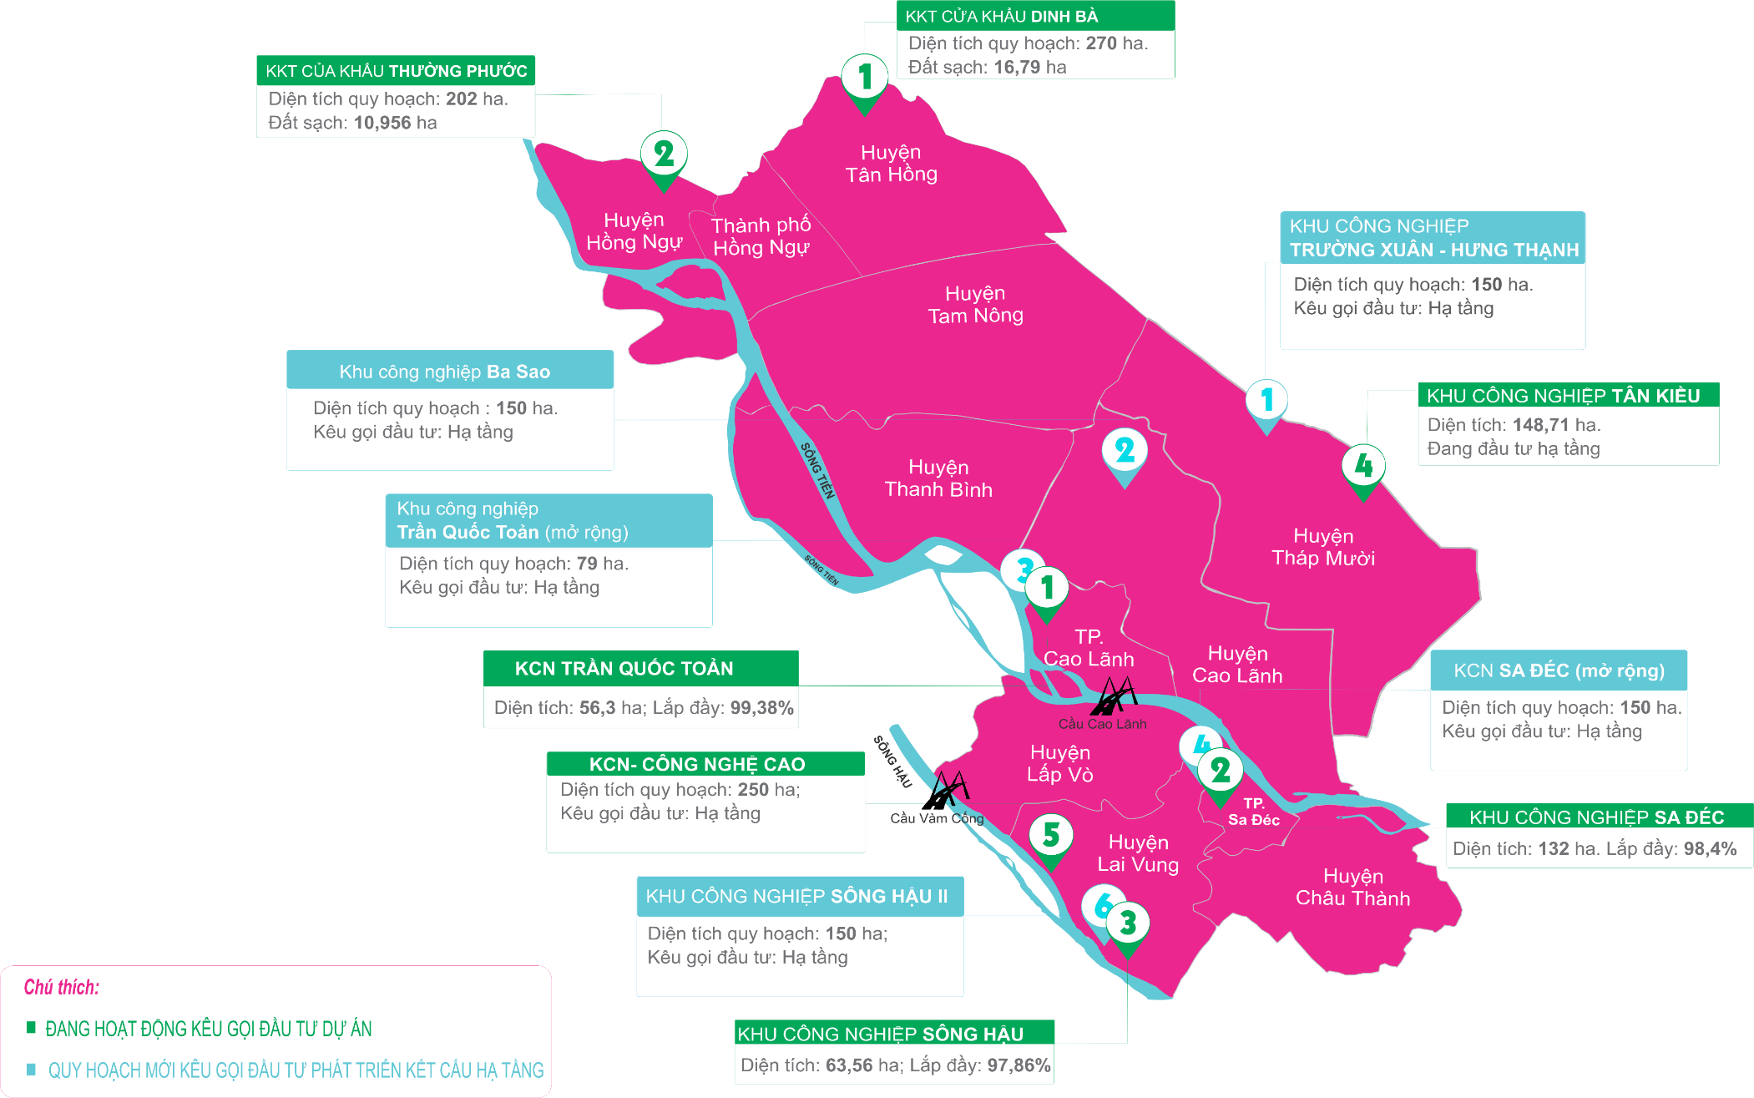
4 Industrial zones established
(Operating: Sa Dec, Song Hau and Tran Quoc Toan)
2 International border economic zones (Dinh Ba, Thuong Phuoc)

Slide 5


“THANK YOU!
“

