Slide 1
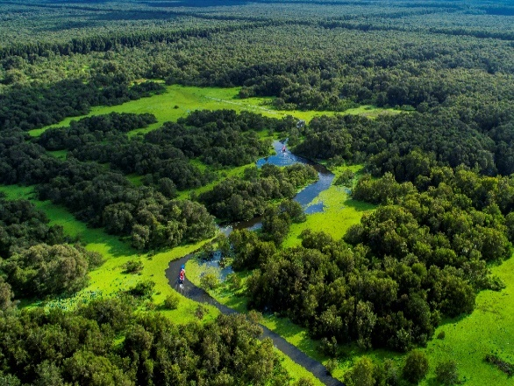
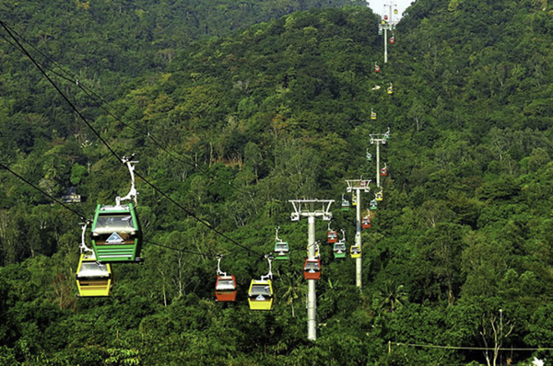
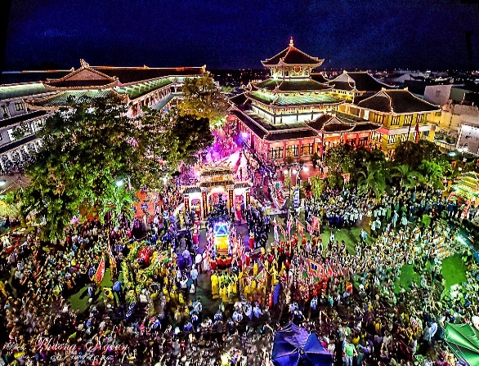
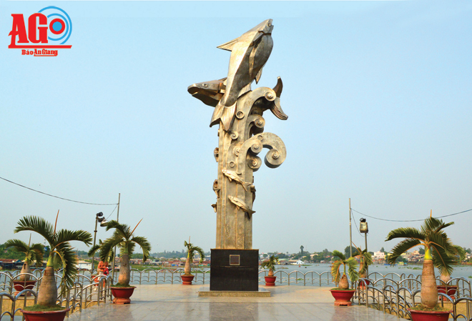
OVERVIEW OF AN GIANG
Location
An Giang is a Southwestern province of Vietnam. It is adjacent to Dong Thap Province in the Northeast, It also borders Can Tho City in the Southeast, Kien Giang Province in the Southwest and the Kingdom of Cambodia in the Northwest with the borderline approximating 100 km with 4 border gates.
Economy
- GRDP growth rate (constant 2010 prices): 5.45%
- Total product per capita: 46 million VND
- Export: 930 million USD / Import: 166 million USD
- Total foreign investment: 38 valid foreign direct investment projects with registered capital of nearly 273 million USD
Investment orientation
In next 5 years, An Giang province identifies two important areas as:
- Key infrastructure Investment at industrial clusters, agricultural production infrastructure, transport infrastructure, urban infrastructure.
- Focus on agricultural development with high technology application on basis of encouraging to rearrangement of cultivated land on that basis form specialized farming areas in association with interests of investors and farmers.
The economic structure
+ Agriculture, forestry and fisheries: 32.86%
+ Industry and Construction sector: 14.40%
+ Service area: 49.09%
+ Product tax minus policy subsidies: 3.65%

Slide 2
INDUSTRY
Index of industrial production by industrial activity (Unit: %)
Year | 2016 | 2017 | 2018 | 2019 | 2020 | Average growth rate in the 2016-2020 period
- Mining and Quarrying | 117,31 | 107,51 | 101,88 | 106,02 | 114,16 | 109,23
- Manufacturing | 104,93 | 107,23 | 109,76 | 108,37 | 104,5 | 106,94
- Electric, gas, steam and air conditioning supply | 107,80 | 103,20 | 104,91 | 124,2 | 118,66 | 111,46
- Water supply; sewerage, waste management and remediation activities | 105,48 | 105,93 | 109,83 | 111,24 | 107,00 | 107,87

Slide 3
INDUSTRY
Number of acting enterprises by kinds of economic activity (Unit: enterprise)
Năm | 2016 | 2017 | 2018 | 2019 | 2020
- Mining and Quarrying | 9 | 18 | 30 | 27 | 29
- Manufacturing | 328 | 419 | 445 | 426 | 440
- Electric, gas, steam and air conditioning supply | 33 | 31 | 27 | 24 | 28
- Water supply; sewerage, waste management and remediation activities | 6 | 11 | 10 | 12 | 15

Slide 4
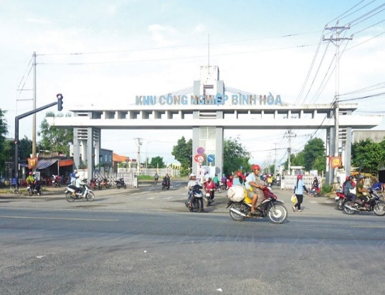
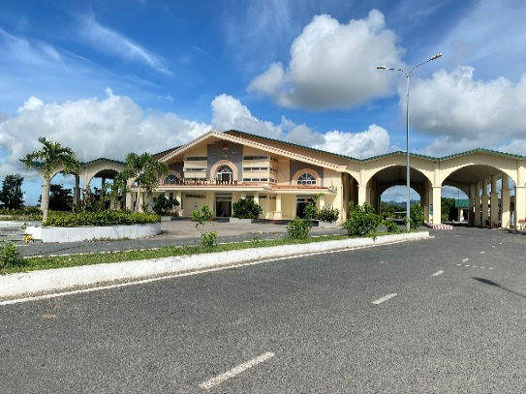
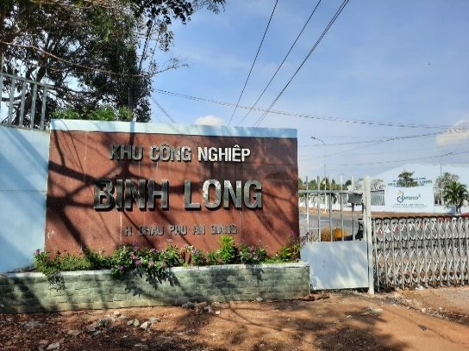
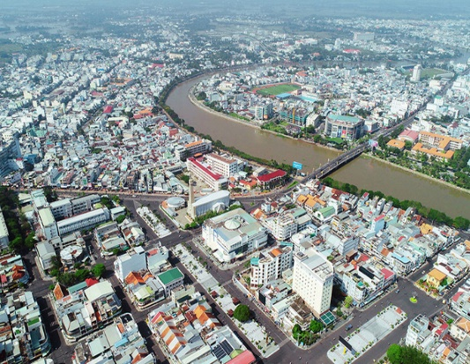
INDUSTRIAL ZONES
Border economic zones
+ Tinh Bien international border area (Tinh Bien district): with a natural area of ​​about 10,100 ha; about 120km from the capital Phnom Penh (Cambodia).
+ Vinh Xuong international border area (Tan Chau town): with a natural area of ​​about 12,487 ha; about 110 km from Phnom Penh capital.
+ Khanh Binh national border area(An Phu district): with a natural area of ​​about 8,140 ha; about 75 km from Phnom Penh capital.
Industrial zones
There are 03 industrial parks with complete infrastructure and put into use, including:
+ Binh Hoa industrial park (Chau Thanh district): 132 ha
+ Binh Long Industrial Park (Chau Phu district): 30.57 ha
+ Xuan To industrial park (Tinh Bien district): 57.4 ha

