Slide 1

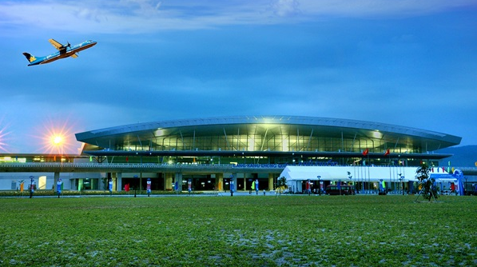
KIEN GIANG PROVINCE -
“THE BEST DESTINATION FOR INVESTMENT”

Slide 2
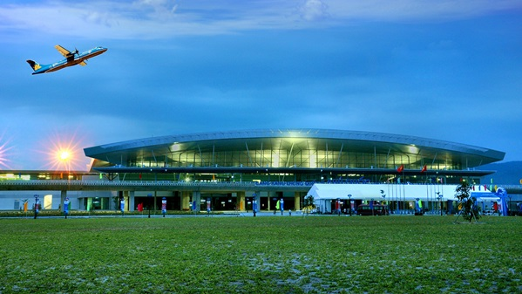
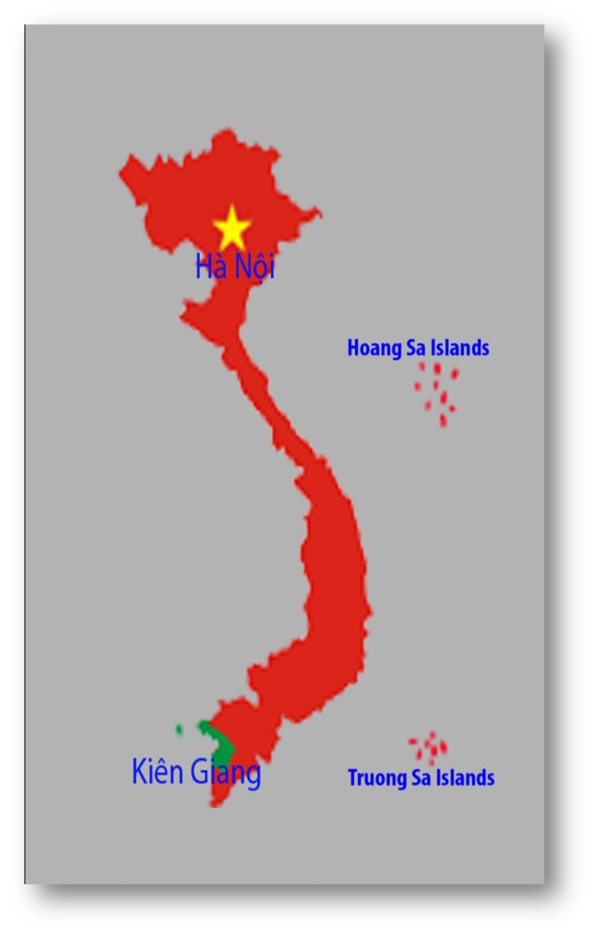
OVERVIEW
Kien Giang province - The Southwest of Vietnam (one of four key economic provinces of the Mekong Delta).
Area: 6.348 km²
Population: 1,7 million (2020)

Slide 3
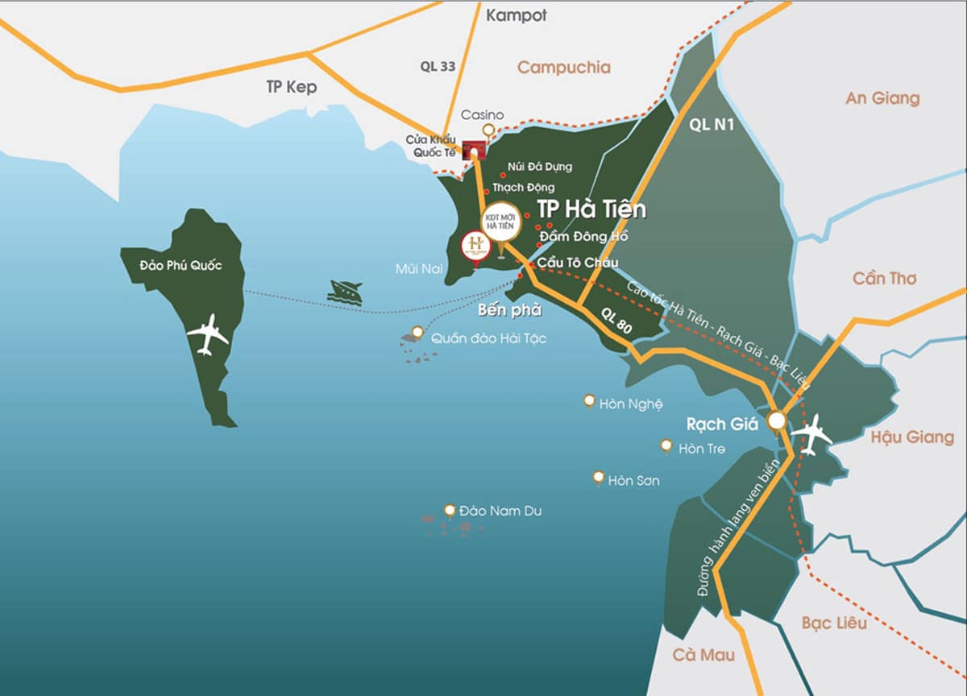
Location
The North: adjoining to the Campuchia (over 56,8km)
Route R10 (The Southern Coastal Corridor) connecting between Thailand – Cambodia and Vietnam via Ha Tien International border-gate.
Facilitate connection of Asean countries by road, waterway and airway.
From Hanoi: 1.967 km
From Ho Chi Minh City: 250 km
From Can Tho: 120 km

Slide 4
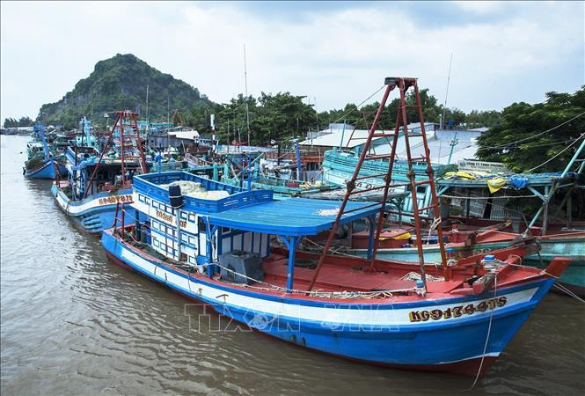
THE ECONOMIC STRUCTURE

Slide 5
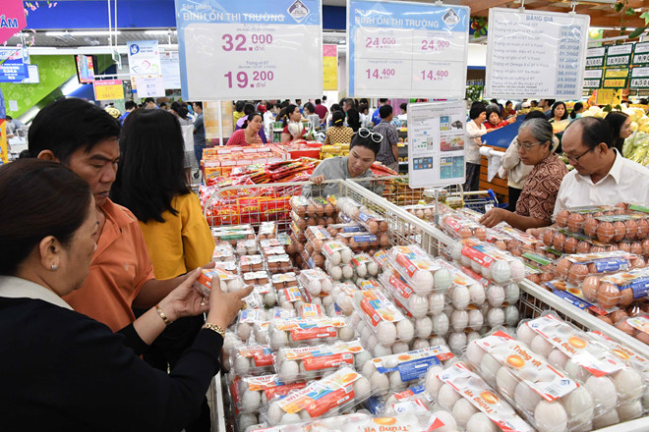
POPULATION
Over 1,72 million.
The average GRDP per person is 55.7 million VND (approximately about 2,418 USD/person/year)

Slide 6
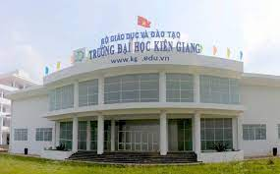
LABOUR
Proportion of the population in working age: 55%
Proportion of trained workforce: 67%
55%

Slide 7

LAND RESOURCES
The land: Alluvial areas, flooded alum areas, saline areas and mountainous areas, islands.
Agricultural land: 407.859 ha (64,2% natural land)
Forestry land: 122.800 ha
Specialized land: 35.400 ha.

Slide 8
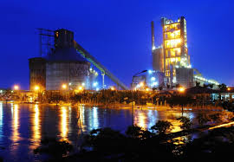
MINERAL RESOURCES
Limestone reserves: 440 million tons, exploiting ability is 342 million tons.
Peat: about 150 million tons (U Minh Thuong, an Minh, Vinh Thuan and Kien Luong districts)
Others: clay for the production of cement, bricks, tiles, ceramics…

Slide 9
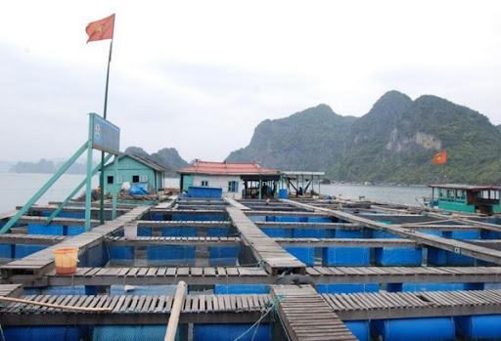
MARINE RESOURCES
200 km of coastline (fishing ground of 63.000 km²)
145 islands.
Fishery reserves: 464.660 tons.
Exploitation allows equal to 44% of the reserve.
Aquaculture area: about 250.000 ha
Fish in cages: over 3.500 cages.

Slide 10
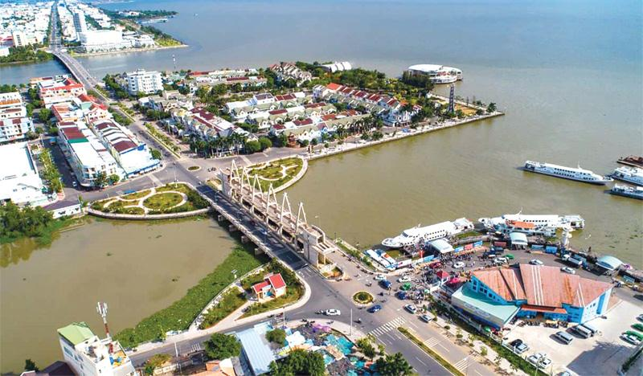
TRANSPORTANT
______
WATERWAY
01 Domestic Passenger Port (Rach Gia).
01 International Passenger Port (Duong Dong – Phu Quoc),
03 Cargo Ports (An Thoi, Vinh Dam – Phu Quoc, Hon Chong – Kien Luong).
Tac Cau Fishing Port

Slide 11
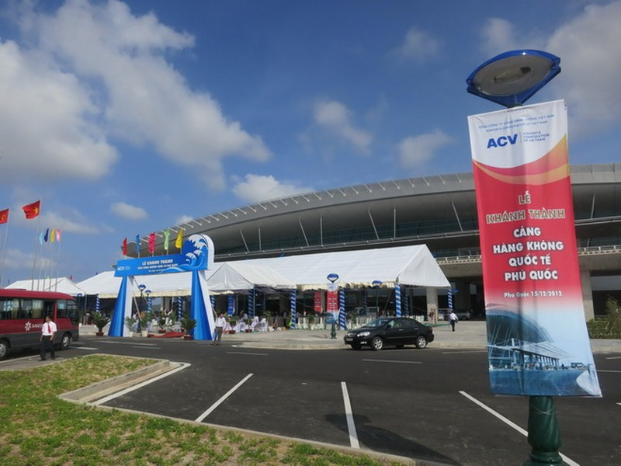
AIRWAY
Phu Quoc International Airport
- In 2020: 3 million customers
- In 2030: 7 million customers (estimated)
- 40 flights/day: China, Russia, UK, Thailand, Singapore, Korea, Cambodia, Sweden, Italy and domestic routes (Hanoi, Ho Chi Minh City, Da Nang, Can Tho,…).
Rach Gia Domestic Airport

Slide 12
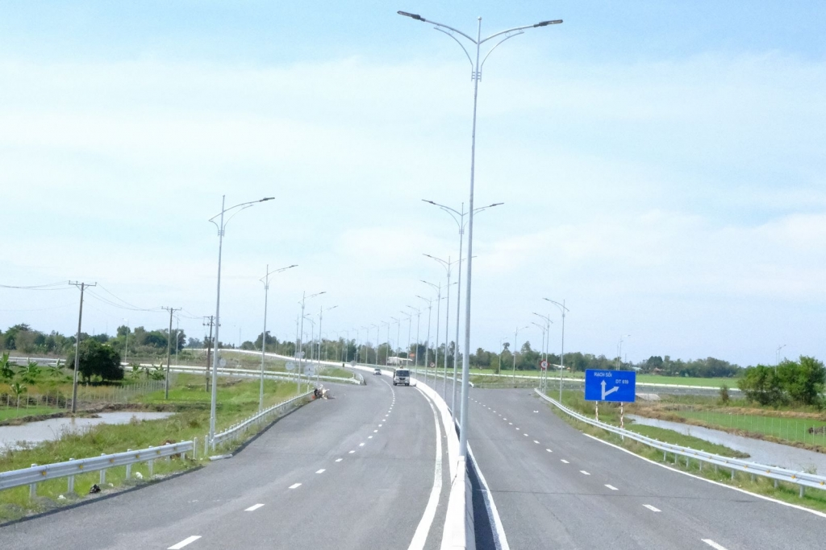
ROAD
- Five (05) national highway connecting with other provinces in the region, 316km (national highway 80, 61, 63 …).
- Provincial road system includes 19 routes, 300km.

Slide 13
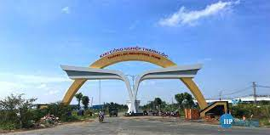
INDUSTRIAL ZONES
Five (5) industrial zones: 765ha (02 deployed industrial zones: Thanh Loc, Thuan Yen).

Slide 14
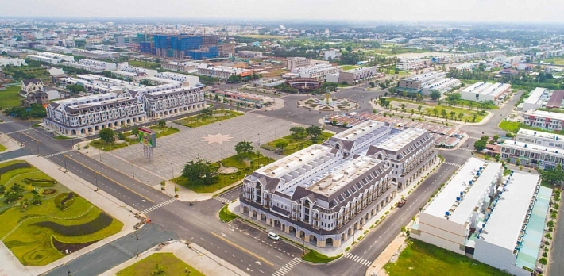
FOREIGN DIRECT INVESTMENT (FDI)
There are 62 FDI projects, 4.8 billion USD (19 countries and territories such as Japan, Thailand, Switzerland, France, UK, HongKong, Korea, Malaysia, Australia, Singapore, USA, Russia, ect).
Ranked 20th in Vietnam and 2nd in the Mekong Delta.

Slide 15
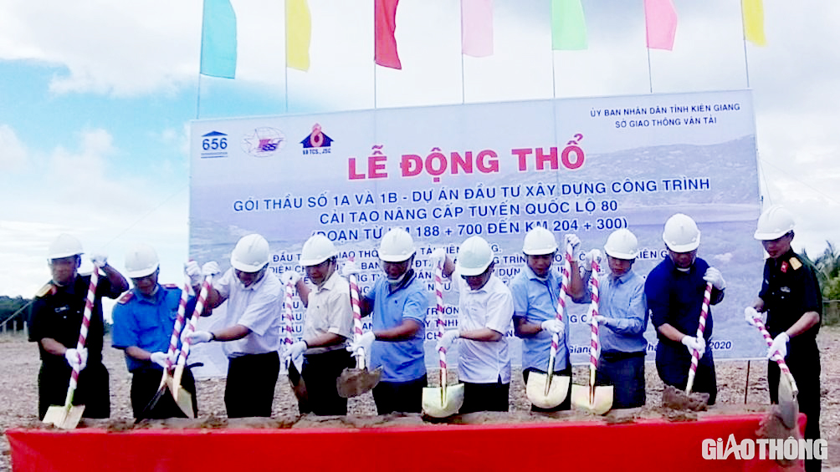
PARTNERS
Japan: 6 projects, about 1,3 billion USD
Thailand: 3 projects, about 700 miilion USD
Switzerland: 2 projects, 441 million USD

Slide 16
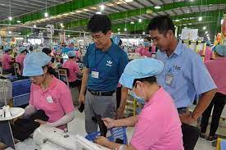
PARTNERS (cont.)
Korea: 09 projects, 51,12 million USD
Investment fields: shoes and leather production and processing; consulting and implementing construction; tourism; restaurant;…

Slide 17
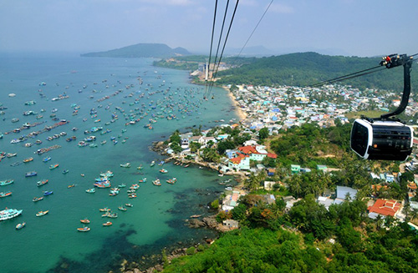
FDI BY FIELD
Real estate.
Manufacturing and processing industry
Extractive
Accommodation and food services
Agriculture, forestry and fisheries
Transportation and warehouse
Education and training
Wholesale and retail; car, motorbike and motorcycle repair
Administrative activities and support services
Information and communication
Professional activities, science and technology
Construction.

Slide 18
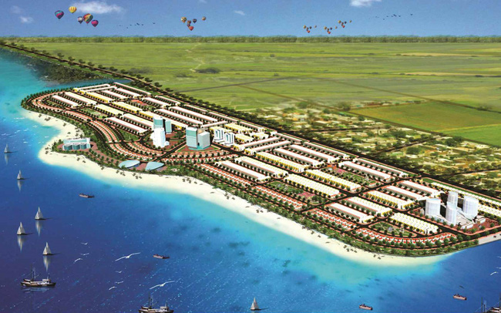
PRIORITY INVESTMENT FIELDS
High-tech agricultural development;
Renewable and clean energy Development;
Tourism;
Trade and services – education and training – medical service;
Marine economy development.

Slide 19
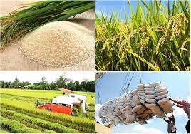
INVESTMENT INCENTIVES
CORPORATE INCOME TAX
LAND RENTAL
IMPORT TAX
- Tax rate of 10% for the first 15 years.
- Tax exemption for 4 years, since the date of taxable income.
- Reduce 50% tax for the next 9 years.
Exempting from land rent, water surface rent during basic construction (not exceeding 3 years) since the decision on land lease
- Tax exemption for machinery and equipment to create fixed assets.
- 05 years exemption for raw materials, supplies and components which cannot be produced domestically.

Slide 20
THANK YOU !
Kien Giang Investment, Trade and Tourism Promotion Center
http://www.kiengianginvest.com
http://www.kiengiangpromotion.vn
http://www.kitra.com.vn
Tel. + 84 2976567088/
+ 84 948771911
Email: trungtamxtdttmdlkg@gmail.com

