Slide 1
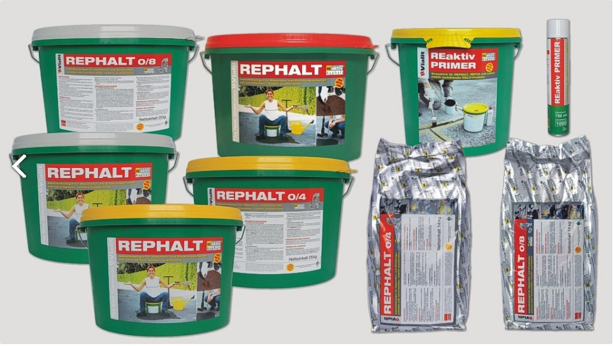

REPHALT
An eco-friendly permanent pothole repair

Slide 2
The Company behind REPHALT?
VIALIT has been producing road construction materials used for repairing and maintaining asphalt roads since 1928.
For more than 80 years our medium-sized company, which today employs some 100 people and is headquartered in Braunau (on the river Inn), has been able to maintain its leading position on the Austrian market.
VIALIT Austria today is controlled by the families Eybl and Hackl. Since its foundation, the company has grown continuously and today has many associated companies and licensees in Germany, Poland, Slovakia, Slovenia, Spain, Czechia and Hungary.
Our group of companies focuses on the production of bitumen emulsions for a wide range of road maintenance and road construction applications.
Our wide range, which includes some 70 products, proves that VIALIT is an expert in this field.
RESTRICTED

Slide 3
What is REPHALT?
Rephalt is a 100% environmentally friendly mixture for the quick repair of asphalt roads. It's proprietary “green” binder reacts and hardens with solely water—unlike other asphalt patching products available on the market today containing toxic petroleum-based solvents with volatile organic compounds. "
The main properties of Rephalt are it is a cold mix asphalt, ease of usage, the rapid opening to traffic, durability, environmental friendliness and value for money.
There are a variety of cold asphalt products, but differ significantly on its properties or its quality.
RESTRICTED

Slide 4
Why REPHALT not Hot Mix Asphalt?
Flexible material that is strong enough to withstand temperature fluctuations.
It can be mixed on site or off site or comes ready mix in a pail and then transported to location.
Eco-friendly option made from water-based materials at ambient temperatures, which reduces emissions, energy consumption and toxic fumes.
Minimal material and transportation costs.
Easy to maintain and recycle.
Cost-effective solution for paving or repairing rural roads that are nowhere near a hot mix plant.
RESTRICTED

Slide 5
REPHALT Applications
Highways (asphalt or concrete),
Runways/Taxiways/Aprons,
Bridge Decks,
Manhole repairs, Potholes,
Utility Cuts,
Parking Lots, Driveways, Tennis Courts,
Pathways
RESTRICTED

Slide 6
REPHALT is present in
Austria
Australia
Germany
Denmark
Romania
Czech Republic
USA
Italy
Portugal
Poland
Bulgaria
Croatia
United Kingdom
Switzerland
Norway
Hungary
Slovenia
Ireland
Belgium
Georgia
Slovakia
Finland
France
Sweden
Turkey
Netherland
New Zealand
Cambodia
Korea
India
RESTRICTED

Slide 7
Material properties of REPHALT
Like other cold mix asphalt, REPHALT consists of:
  Binding agent
    Our proprietary Reactive Binder Technology (RBT) binder is characterised by their extremely good adhesion properties to the stone. RBT is a further development of the “Raps-Asphalt” technology. “Raps-Asphalt” is a plant based binder with bitumen. This binder contains natural rape seed oil which improves stability
    Addition of water causes a reaction of this special binding agent
  Stones/ Aggregates
    In addition to its grain size, an important requirement for stone is its strength. Ideally, stones used should have grain-graded grading curve. This will ensure good pliability and gives optimum stability. Therefore stones used in REPHALT are grain graded and approved by Austrian Department of Transport.
RESTRICTED

Slide 8
Specifications
 | REPHALT 0/4 | REPHALT 0/8 | REPHALT 0/11
Grain size | 0-4mm | 0-8mm | 0-11mm
Binder content | 7-8% | 7-8% | 5.5-6.5%
Softening temperature of hardened condition | 70-75ºC | 70-75ºC | 70-75ºC
Bulk density | ca. 2.2g/cm³ | ca. 2.3g/cm³ | ca. 2.1g/cm³
Marshall Stability (after 24 hrs at 60oC in water quench) Stability Flow rate | >3kN 2.0 – 5.0mm | >4kN 2.0 – 5.0mm | >4kN 2.0 – 5.0mm
Step on time | Immediate | Immediate | Immediate
Yield | Approx.1m2 @ 1cm depth | Approx.1m2 @ 1cm depth | Approx.1m2 @ 1cm depth
RESTRICTED

Slide 9
Method Statement of Work
Sweep out all loose material and standing water from area to be repaired
Remove pail lid cover & check that seal is intact. Do NOT USE if seal is broken as REPHALT would have hardened when in contact with atmospheric moisture.
Place REPHALT beside pothole with shovel or trowel and sprinkle water at approximately 0.5 – 1 litre per 25kg pail. Mix well with shovel or trowel to start the curing process.
Place the “wet” Rephalt into the pothole and level with a rake or trowel allowing finished level of REPHALT to be about 40mm above surrounding area
……..continue
RESTRICTED

Slide 10
Method Statement of Work
Compact to smooth finish (slightly crowning so no water ponding) with tamper, vibrating plate or hand roller. If compacted material is below the level of the surrounding area, add more “wet” REPHALT and compact as above.
If depth of the pothole is greater than 150mm it is advisable to carry out the repair in two stages
  Fill and compact “wet” REPHALT and compact to half the depth of the pothole, and then
  Repeating the procedure as above
Thickness per layer for compaction:
  REPHALT 0/4 minimum 1.5cm – maximum 4cm
  REPHALT 0/8 minimum 2.5cm – maximum 6cm
  REPHALT 0/11 minimum 3.5cm – maximum 8cm
RESTRICTED

Slide 11
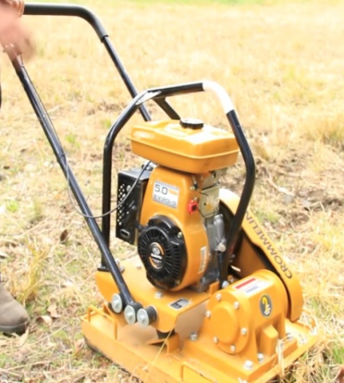
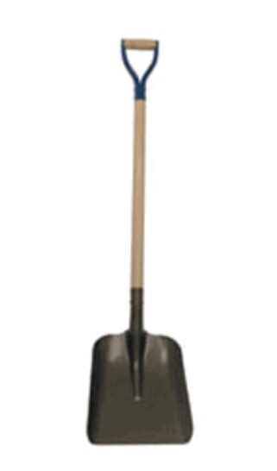
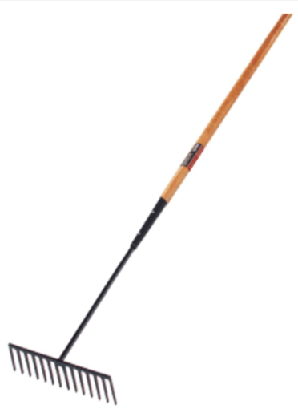
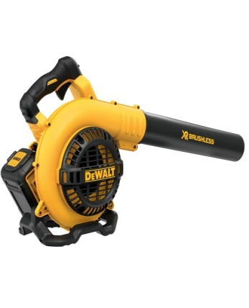
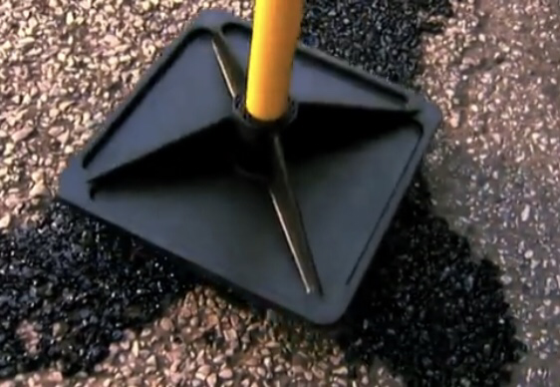
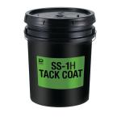

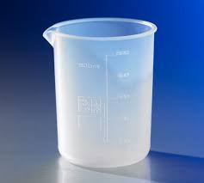
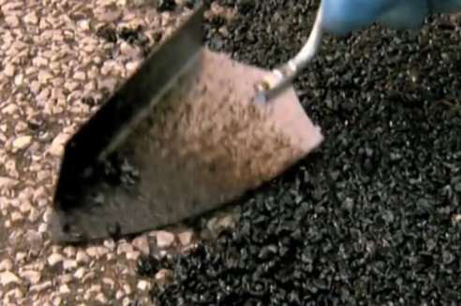
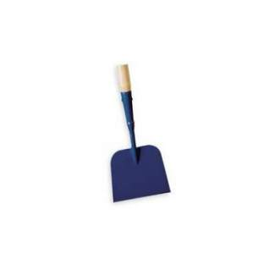

Equipments
Shovel
Rake
Tamper
Blower
Vibrating compactor
Tack coat
Brush
Trowel
Scraper
2L measuring cylinder
RESTRICTED

Slide 12
Things to consider
Just like any other cold mix asphalt, REPHALT should only be applied over a base or pavement that is in pretty good condition and does not have any base or drainage defects.
If there are distresses in the base or pavement, repairs must be made prior to applying REPHALT for best results.
Emulsion tack coat is recommended for concrete pot holes.
RESTRICTED

Slide 13
Storage & Handling
Store indoors in cool, dry conditions. Avoid direct sunlight.
Avoid damage to conatiners. Seal must not be broken until immediately before use.
All material must be used within 24 hours after breaking the seal.
Pack cannot be resealed for later use, as material exposed to atmospheric moisture will harden.
Gloves should be worn. In event of contact, use proprietary hand cleaners, medicinal paraffin, or vegetable oil or butter.
REPHALT can be kept for up to 8 months. If properly stored, 1 year is possible.
Coverage rate: Approximately 1m2 per 25kg @ 1cm depth
RESTRICTED

Slide 14
In summary, REPHALT is
Premixed and can be laid directly from container
Environment and user friendly
Solvent free
Sets quickly, to provide a long lasting repair.. In wet or cold conditions. Less disruption to traffic
Installed at ambient temperature. Unlike HMA, there is no need to worry about any required minimum temperature to install.
Easy and quick to apply. Two men can do the work in three steps (1) Clean the hole,(2) mix the Rephalt with water , fill the hole and (3) compact then off to the next hole.
Permanent solution to pot hole repair. Saves money (man-hour and life-cycle costs) and time.
RESTRICTED

Slide 15
Thank you for considering REPHALT
RESTRICTED

