Slide 1
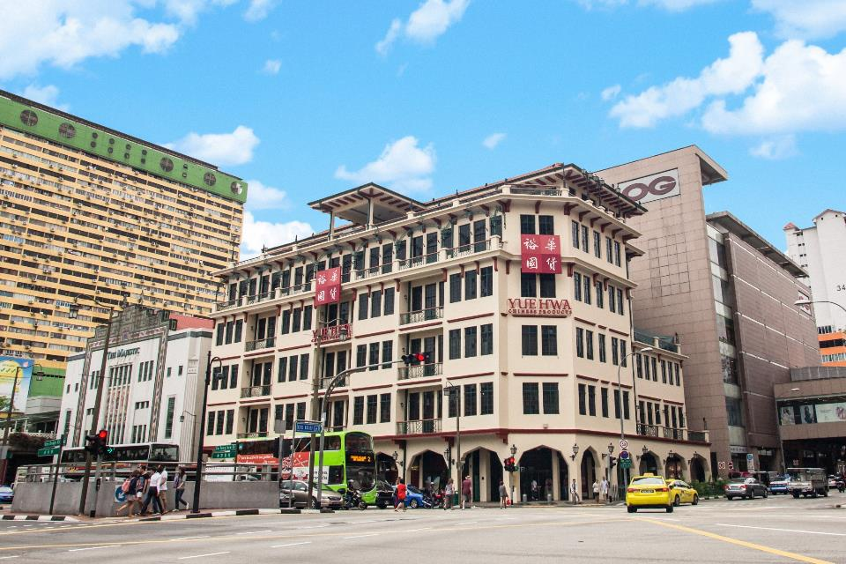

Slide 2
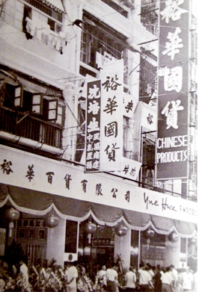
Company Background
Since its establishment in 1959, Yue Hwa's commitment to the Hong Kong community has served to consolidate its position as one of the leading retail groups offering Chinese and other quality products.
We have expanded our operation to serve not only the needs of our local consumers, but also tourists and travellers from abroad. It is our goal, as one of the well-established retail groups in Hong Kong, to supply consumers with a diversified range of Chinese products and other brand-names in accordance with our stringent standards of quality and affordability.
As we look ahead, our aim is to nurture a trusting relationship where we understand our customer’s, allowing us to serve and to better fulfil their consumer requirements. Upon these foundations and always keeping abreast of the trend, we hope that your support and patronage could be continually counted upon in our endeavor towards building a prosperous future.
裕华于1959年在香港创立，一直都保持创业初衷并尽心地服务香港社区成为其中一家领先的零售公司。
裕华不仅为当地顾客提供优质、地道的中国产品，也不忘弘扬及推广精选中华产品给外国游客。裕华国货，取意“富裕中华”。我们的目标是与顾客建立长远的互信关系，并了解他们的需求。

Slide 3
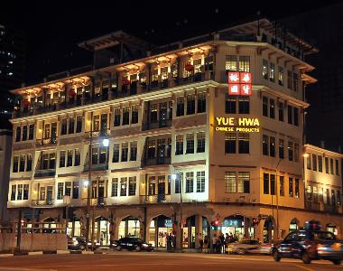
Company Profile
In year 1996, Yue Hwa Singapore commenced operations as the brand’s flagship store. Yue Hwa Chinatown, is a Singapore landmark. Housed in the former Nam Tin Hotel and conveniently located next to Chinatown MRT station, the store combines both contemporary and original architecture, and features an entirely new extension, screen walls and stained glass skylights, all of which complement the building's rich historical character.
Yue Hwa also has three other branch stores in Singapore; Yue Hwa Jurong (located at Jurong Point Shopping Centre), Yue Hwa Kovan (Heartland Mall),Yue Hwa Yishun (Northpoint City) and Yue Hwa Simei (EastPoint Mall). These stores are conveniently located in shopping malls with direct MRT station access, and offer the same, popular range of Chinese medicine, food, tea and wine available at Yue Hwa Chinatown.
1996年， 裕华登陆新加坡的牛车水。裕华国货的前身为南天酒楼，据说是新加坡第一家装置电梯的酒店，目前已列为国家保留建筑物。
裕华国货在新加坡增设了4间分行，位于裕廊坊、高文心邻坊、义顺纳福城，四美东福坊。它们都坐落在方便的地铁站附近。同样的药材、食品、茶叶和名酒也可在牛车水总店购买。
Yue Hwa Chinese Products in Singapore

Slide 4
Key Milestones @ Yue Hwa Chinese Products 裕华国货主要里程碑
Year | Key Achievement
1993 | Purchased Great Southern Hotel 购获南天酒楼
1996 | 9th October Yue Hwa Singapore commenced operations 裕华国货新加坡首间店开幕
1997 | Architectural awards 获得国家保留建筑物奖
2008 | Dec 15, Jurong Point store opened 裕廊坊店开幕
2012 | Jan 7, Junction 10 store opened 十里广场开幕
2014 | Nov 11, Centrepoint store opened 先得坊开幕
2015 | Received Singapore Quality Class award. The Singapore Quality Class is a government recognized certification issued by SPRING Singapore. It recognizes organisations for business practices that meet good performance. 获得新加坡素质等级认证
2016 | March 18, Kovan Store opened高文心邻坊开幕
2016 | June 28, Simei Store opened四美东福坊开幕
2017 | Dec 18, Yishun Store opened 义顺纳福城开幕

Slide 5
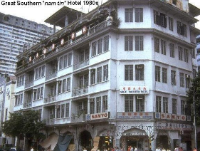
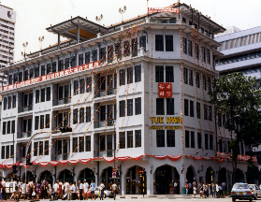
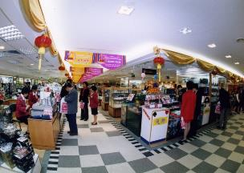
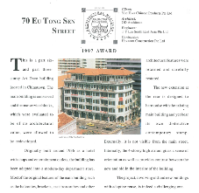
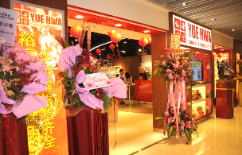
Key Milestones @ Yue Hwa Chinese Products Singapore 裕华国货新加坡主要里程碑
1993 Purchased Great Southern Hotel 购获南天酒楼
1997 Architectural awards 获得国家保留建筑物奖
2008 Dec 15, Jurong Point store opened 裕廊坊店开幕

Slide 6
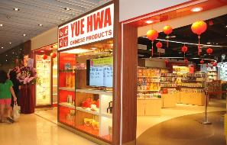
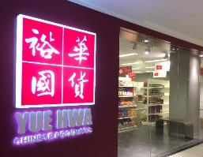
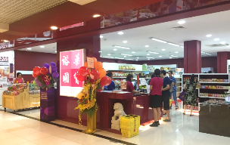
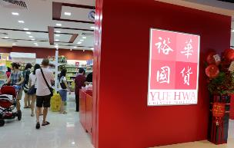
Key Milestones @ Yue Hwa Chinese Products Singapore 裕华国货新加坡主要里程碑
2012 Jan 7, Junction 10 store opened 十里广场开幕
2014 Nov 11, Centrepoint store opened 先得坊开幕
2016 March 18, Kovan Store opened高文心邻坊开幕
2016 June 28, Simei Store opened四美东福坊开幕

Slide 7
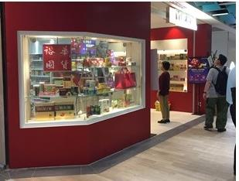

2017 Dec 18, Yishun Store opened 义顺新店开幕

Slide 8
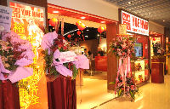
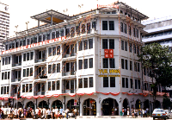
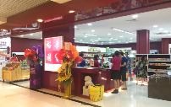

Our current stores 裕华店面
Yue Hwa Hong Kong
裕华香港
Yue Hwa Singapore
裕华新加坡
Jurong point
裕廊坊
Chinatown HQ
牛车水总店
Simei
Eastpoint Mall
四美东福坊
Yishun
Northpoint City
义顺
Kovan Heartland Mall
高文心邻坊

Slide 9



Our Corporate logo 我们的标志
秉承现有， 同事让人感觉与时并进。

Slide 10
Our Vision 我们的意愿
Proliferate Chinese Culture and diversity with quality, integrity and respect.
以品质，诚信与尊重传承和弘扬中华文化。
Our Mission 我们的使命
To serve the ethnic Chinese community with quality Chinese products.
To promote quality Chinese products to the market that is value for money.
以优质商品服务华人社群。向市场推广物有所值的优质中国商品。
Our Service Vision 我们的服务宗旨
Yue Hwa’s service vision is to make our shopper feel indulge in enjoyable remembrance of the Chinese tradition.
We brings it closer to you, especially for those who appreciates the culture, and for the younger ones to experience it.
裕华国货的服务意愿是让顾客享受及欣赏中华文化的精髓。
我们把这流传上几千年的传统文化带给您，是给中华爱好者同时也让年轻一辈学习及感受其中传承的经典。

Slide 11

Our Signature Products 我们的商品
Healthcare 医药保健
Beauty & Fragrance 美妆香水
Food 食品
Wine & Tea 茶酒
Fashion & Jewellery 服装& 首饰
Arts craft 工艺品
Furniture 家具

Slide 12
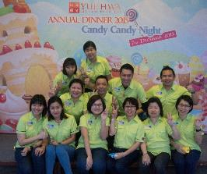
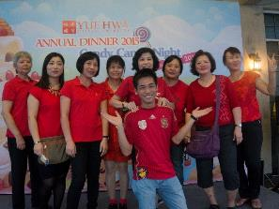
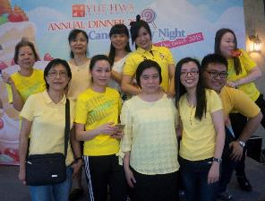
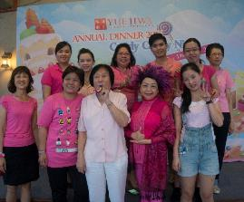
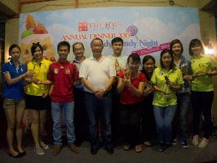
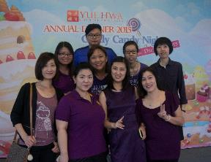
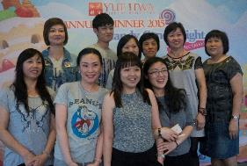
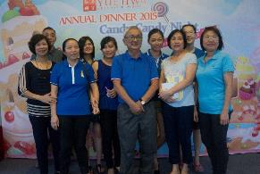
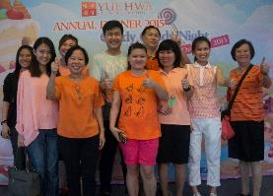
Our People 我们的团队

Slide 13
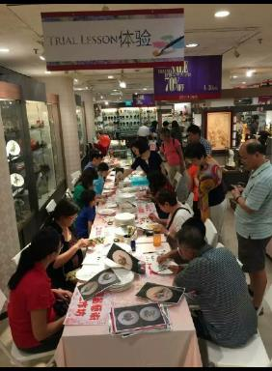
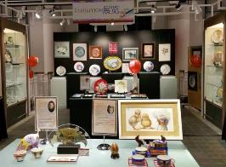
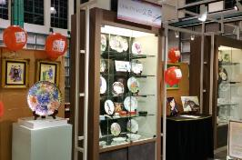
Our Social Responsibility 我们的社会责任
2016 Jun, Yue Hwa organize Art& craft Charity Sale together with Singapore Diabetic Society at Yue Hwa building .
Yue Hwa donate 1 to 1 amount of the charity sale to Singapore Diabetic Society.
2016年六月，裕华国货与新加坡糖尿病协会举办筹款活动，全部义卖所得裕华以一对一的方式捐赠给新加坡糖尿病协会。

